Slide 1



FGM & the best interest of the child
Prevention
Fabienne Richard
Midwife, MSc, PhD
Executive Director of GAMS Belgium
Seydou Niang
MSO Peer educator coordinator
28 January 2016, Bruxelles

Slide 2

GAMS in short
Started in 1996 (20th anniversary this year !)
Mission: Support women living with FGM and prevent FGM on girls at risk
Multidisciplany team (8 EFT) + volunteers
Access to the services 5/7days from 9am to 5 pm
Sub-offices in Flanders & Wallonia since 2013

Slide 3
Good practices
Professionals:
  Guideline targeted to key sectors
  Training of FGM focal point in the different services
Community sensitisation:
  Prenatal workshop
  Well-Baby clinics activities
  Engaging Youth
  Engaging Women AND Men

Slide 4
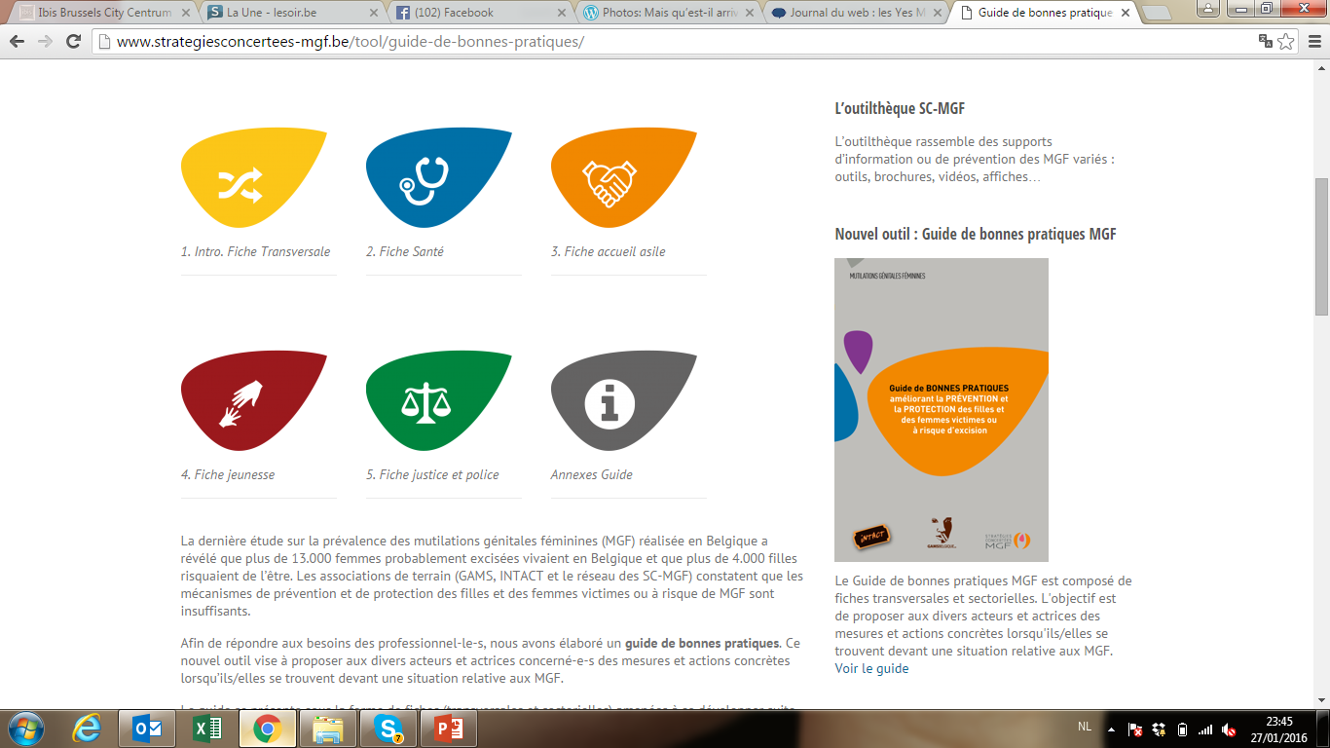
Guidelines targeted to key sectors

Slide 5

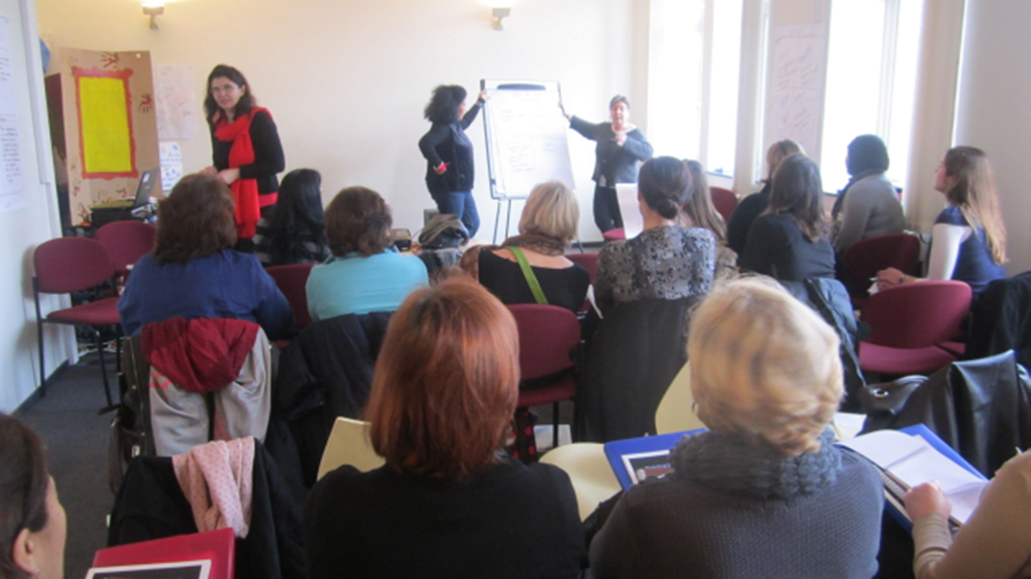
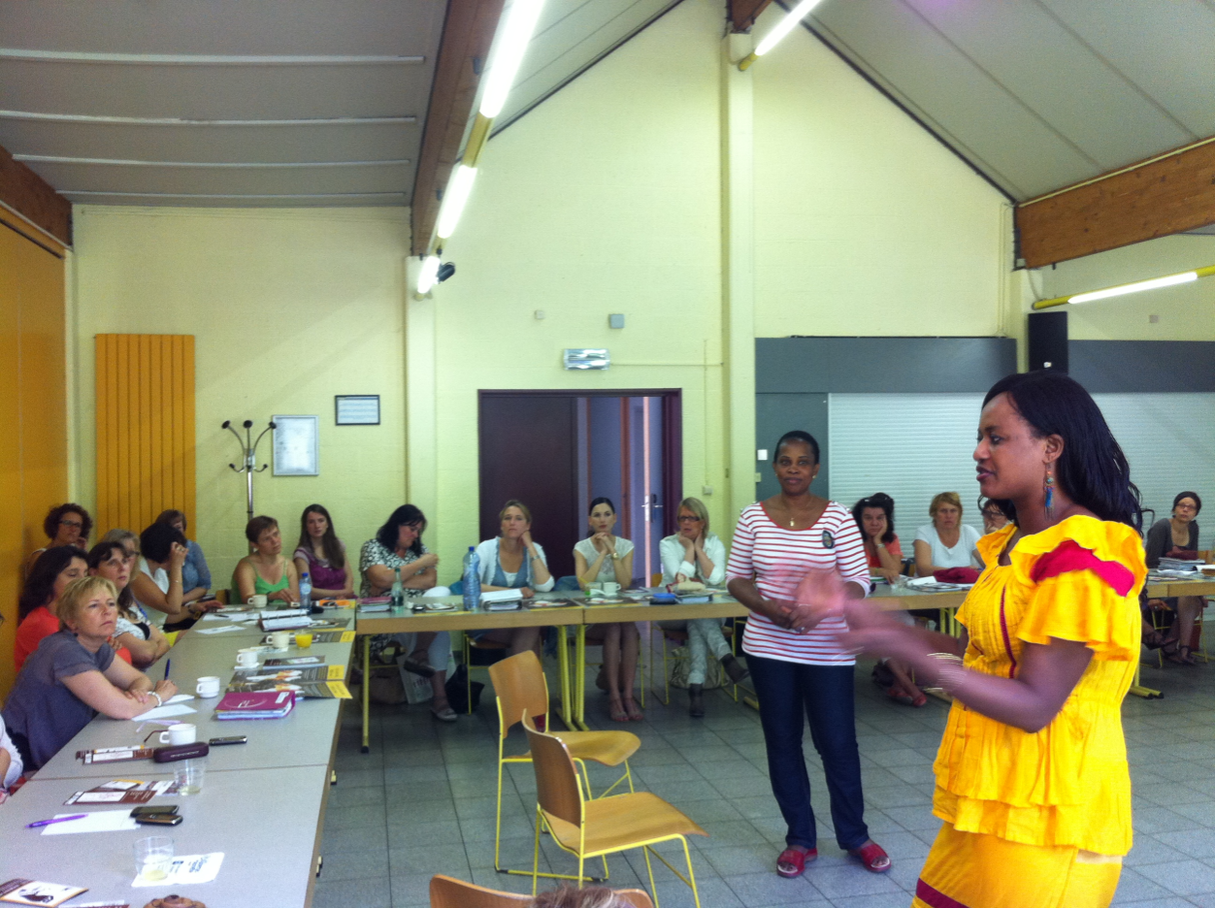
Training of FGM focal point
Midwives FGM focal point
Health prevention professionals

Slide 6
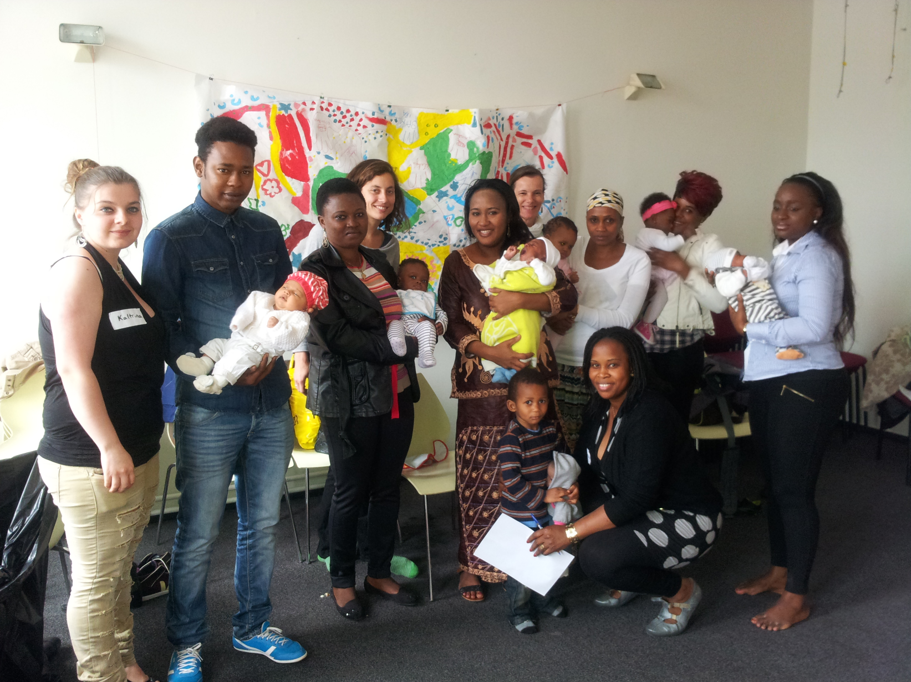
Prenatal Workshop

Slide 7
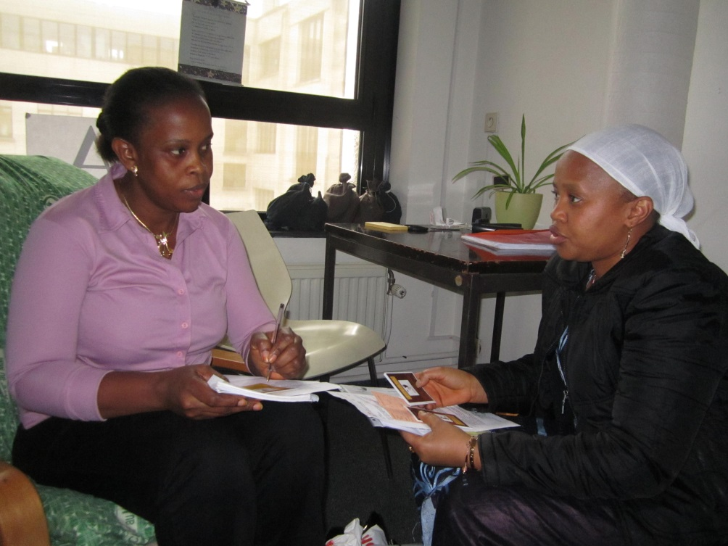
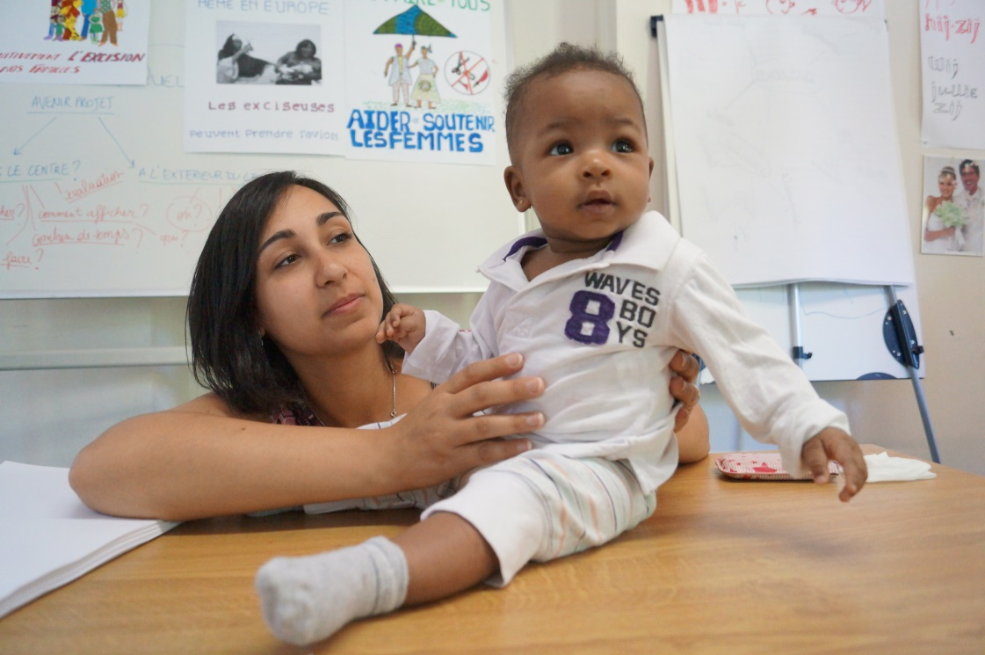
Counseling during well baby clinics
Partnership between GAMS & ONE (Office of Birth and Childhood)

Slide 8

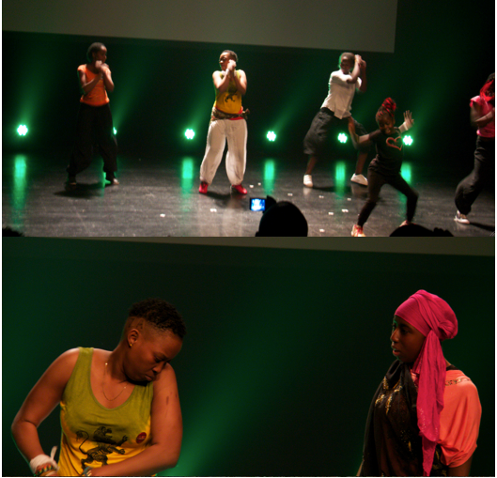
Sensitisation in school
Youth workshops

Slide 9
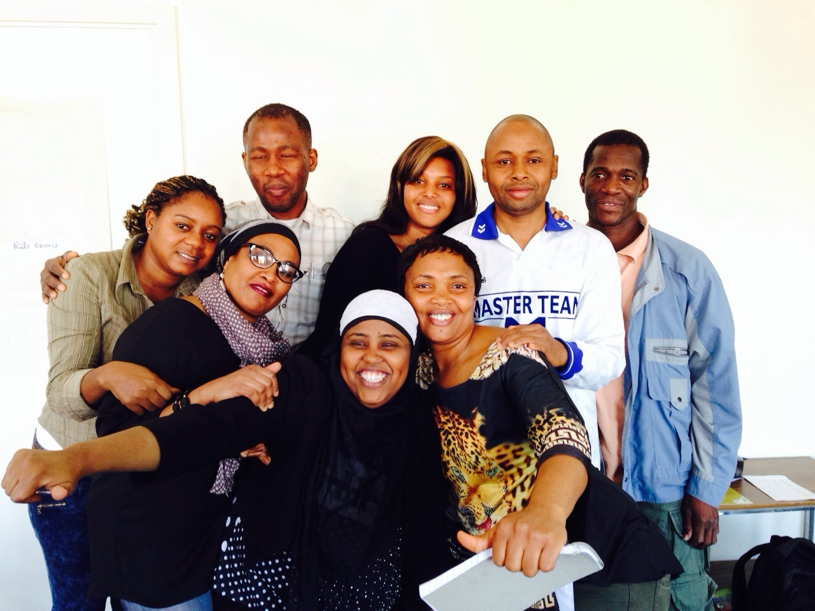
Engaging Woman AND Men

Slide 10


Exemple of Men Speak Out Project
Co-funded by the Daphne programme of the European Union
www.menspeakout.eu

Slide 11
3 top priorities
Funding for community work and not only for conference, guidelines,…
Access to specialised care for every migrant woman with FGM
→ the best way to protect a child from FGM is to take care of the mother
Networking, coordination between the different services to have more impact (national coverage, standardisation of tools, better use of the resources)

