Slide 1

The END FGM
European Network
Brussels, 28 January 2016
Best Interests of the Child in FGM Related Cases
ANNE – MARIE HUTCHINSON

Slide 2
Child Protection Issues
The introduction of specific civil remedies to protect victims or potential victims of FGM should not be viewed as a replacement for child protection measures.
It would be highly unusual where there is a real threat of FGM where it has occurred where the general child protection jurisdiction was not also invoked.
In England and Wales our starting point would be the Children Act 1989. If the child is abroad it will be the Wardship/Inherent Jurisdiction.

Slide 3
Best Interest/Welfare of Children
Section 1 of CA states
Welfare of the child.
(1)When a court determines any question with respect to—
(a)the upbringing of a child; or
(b)the administration of a child’s property or the application of any income arising from it,
the child’s welfare shall be the court’s paramount consideration.

Slide 4
Children Act 1989
In England and Wales we would consider whether we should obtain orders under the Children Act 1989
Section 31 – Care and Supervision Orders (Local Authority/Social Services)
Child = under age of 17 years
Places child in care of Social Services
Threshold:-
The child concerned is suffering or likely to suffer significant harm and
The harm or likelihood of harm is attributable to
(a) the care given to the child or likely to be given to him if the order were not made, not being what it would be reasonable to expect a parent to give him.
Section 44 - Emergency Protection Orders (Police)

Slide 5
FGM Specific Legislation
There is FGM specific legislation in England and Wales which is utilised in order to prevent FGM from taking place or to protect a child who may have already been subjected to FGM.

Slide 6
Female Genital Mutilation Act 2003
Under the Female Genital Mutilation Act 2003 a person was guilty of the offence of FGM in the following circumstances:
Offence of female genital mutilation
Offence of assisting a girl to mutilate her own genitalia
Offence of assisting a non-UK person to mutilate overseas a girl’s genitalia

Slide 7
Serious Crime Act 2015
The Female Genital Mutilation Act 2003 was amended by the Serious Crime Act 2015. The SCA inserted the following:
Offence of failing to protect girl from risk of genital mutilation
Female genital mutilation protection orders
Duty to notify police of female genital mutilation

Slide 8
Section 3A Offence of failing to protect girl from risk of genital mutilation
(1)If a genital mutilation offence is committed against a girl under the age of 16, each person who is responsible for the girl at the relevant time is guilty of an offence.

Slide 9
Impact of duty on individuals
Section 3A (2)For the purposes of this section a person is “responsible” for a girl in the following two cases.
(3) The first case is where the person—
(a)has parental responsibility for the girl, and
(b)has frequent contact with her.
(4)The second case is where the person—
(a)is aged 18 or over, and
(b)has assumed (and not relinquished) responsibility for caring for the girl in the manner of a parent.

Slide 10
FGMPOs
Power to make FGM protection order:
1(1)The court in England and Wales may make an order (an “FGM protection order”) for the purposes of—
(a)protecting a girl against the commission of a genital mutilation offence, or
(b)protecting a girl against whom any such offence has been committed.

Slide 11
Application
An application may be made:
By the girl who is to be protected by the order, or a relevant third party.
Ex parte (without notice)
At the county court or high court
Where there are complex issues and ancillary orders such as passport orders are required, the application must be made at the High court.

Slide 12
High Court Jurisdiction
Court has wide powers under inherent jurisdiction, where the children is court of jurisdiction and at risk of FGM, they need to be involved ay High Court.
A v A [2013] EWHC 3554 (Fam) – extended the jurisdiction to state that if you have a British national overseas you still have jurisdiction. This is a useful tool in FGM cases where child is a British national but may not have lived here or not lived here for a long time or has lawfully been sent to another jurisdiction and the child becomes at risk of FGM

Slide 13
High Court Orders
If the application is made at the High Court we can protect a girl by obtaining the following orders if required:
Prohibition of the FGM procedure taking place
Passport order to prevent the removal of the girl from the jurisdiction
Return to the UK if she has already been removed
Port Alerts can be put in place

Slide 14
Case Study
There was a British girl of age 7, she was ethnically Somalian.
Her primary carer was her maternal aunt and father. Her mother was in Somalia.
The mother returned from Somalia and stated she wanted to care for the daughter.
She removed the daughter from the maternal aunt’s care and took her to Somalia.
The girl was at risk of FGM, as her mother and maternal aunt had undergone the procedure and this was viewed as a normal practice in the family.
Father issues FGM and Wardship proceedings.

Slide 15
Case Study Continued
We obtained the following orders:
FGM orders to prevent the procedure
Wardship order for return of the girl to the UK
We were able to obtain a passport order against the maternal aunt in order to find out the location of the child

Slide 16
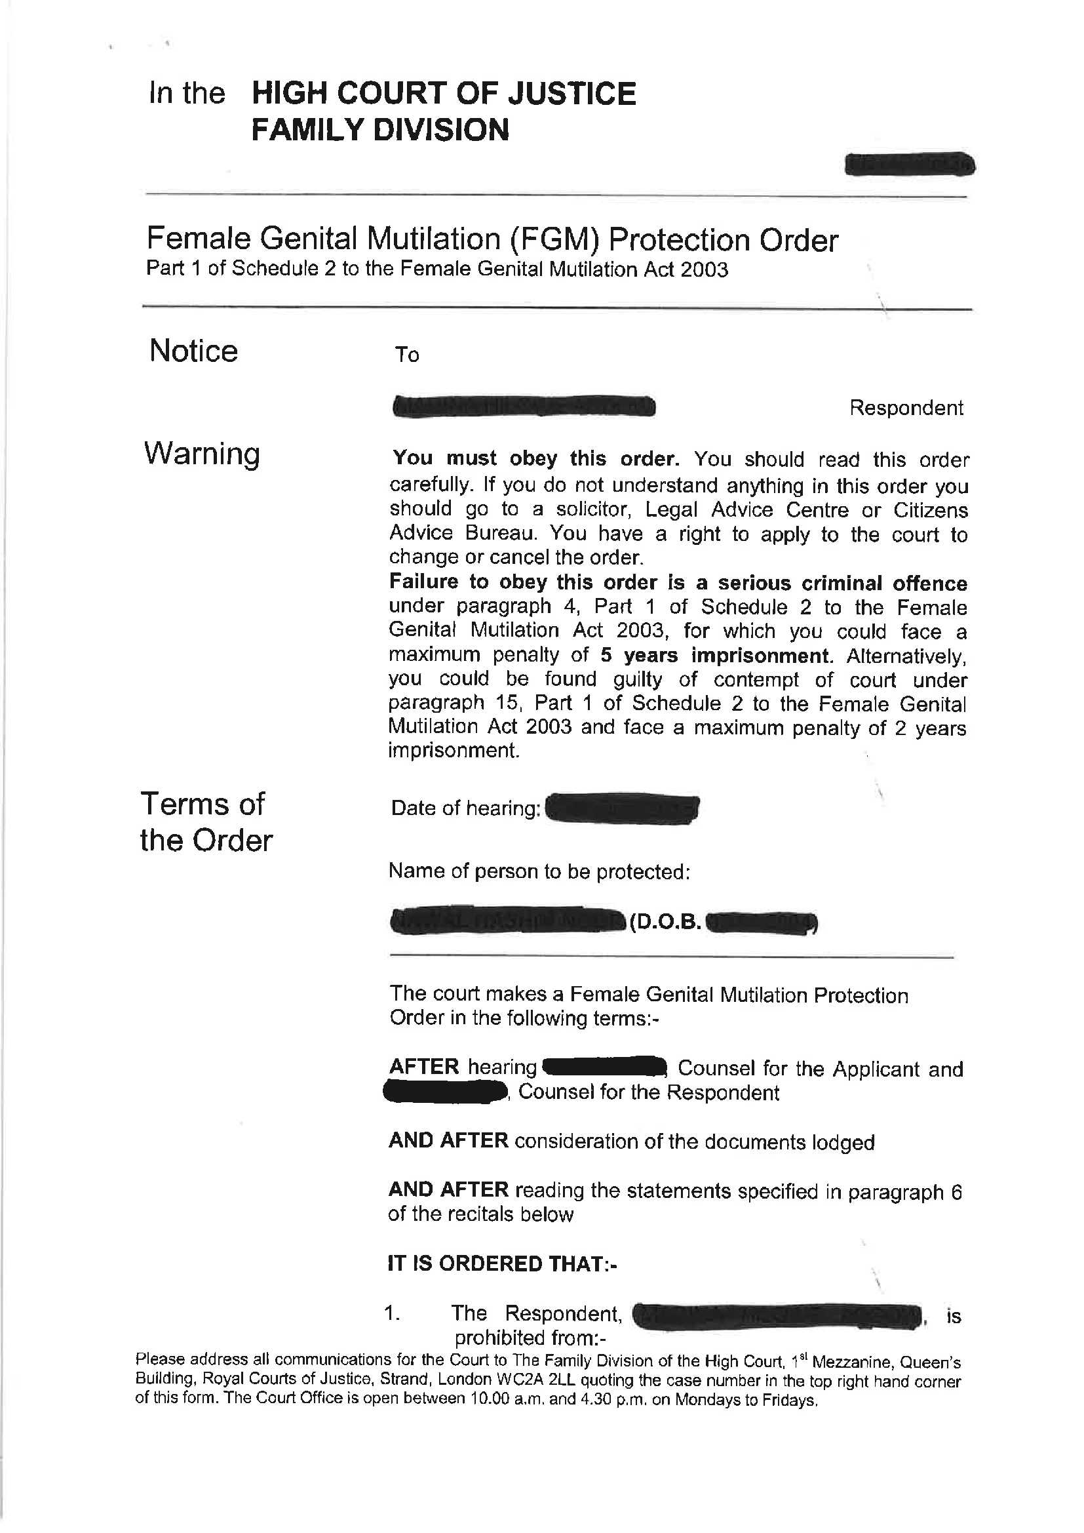
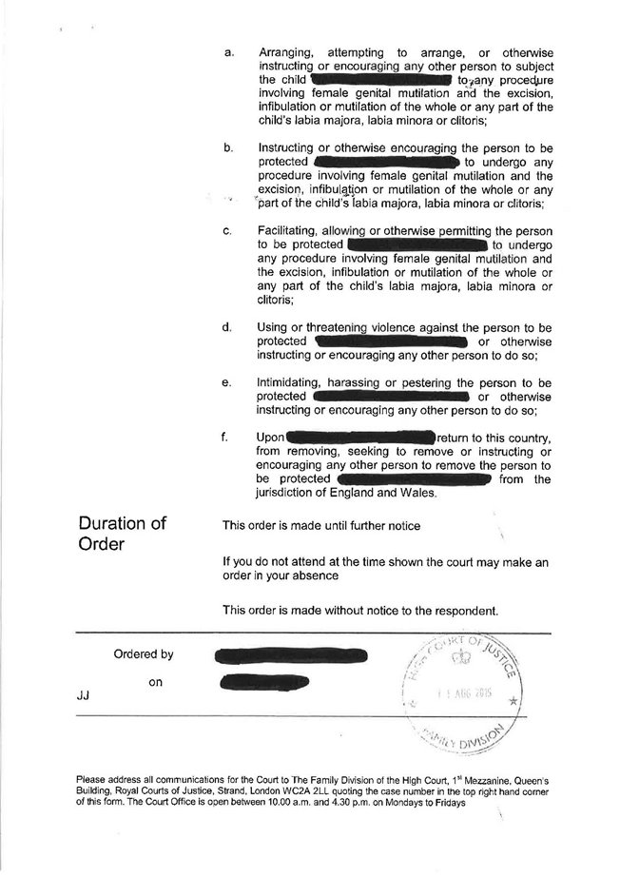
FGMPO Court Order

Slide 17
Wardship Order

Slide 20
FGMPO
It is possible to envisage a situation where in all other respects the parents are good parents and there are no other risks should that child remain in the family home with the parents.
THE FGMPO should prevent any risk of FGM in the future, the child could live with the family, so long as the parents accept the action is wrong, co-operate with authorities and support workers, and submit to an order.

Slide 21
Mandatory Duty to notify police of female genital mutilation
There is now a mandatory duty to notify the police of FGM.

Slide 22
Section 5B Duty to notify police of female genital mutilation
(1)A person who works in a regulated profession in England and Wales must make a notification under this section (an “FGM notification”) if, in the course of his or her work in the profession, the person discovers that an act of female genital mutilation appears to have been carried out on a girl who is aged under 18.

Slide 23
Professionals Effected
A person works in a “regulated profession” if the person is—
(i)a healthcare professional, (a person registered with any of the regulatory bodies mentioned in section 25(3) of the National Health Service Reform and Health Care Professions Act 2002 (bodies within remit of the Professional Standards Authority for Health and Social Care) )
(ii)a teacher, or
(iii)a social care worker in Wales;

Slide 24
Duty Arises at Point of ‘Discovery’
A person “discovers” that an act of female genital mutilation appears to have been carried out on a girl in either of the following two cases.
Where the girl informs the person that an act of female genital mutilation (however described) has been carried out on her.
2. Where—
(a)the person observes physical signs on the girl appearing to show that an act of female genital mutilation has been carried out on her, and
(b)the person has no reason to believe that the act was, or was part of, a surgical operation within section 1(2)(a) or (b).

Slide 25
Notification Procedure
Under Section 5B(5) the following procedure is to be followed
An FGM notification—
(a)is to be made to the chief officer of police for the area in which the girl resides;
(b)must identify the girl and explain why the notification is made;
(c)must be made before the end of one month from the time when the person making the notification first discovers that an act of female genital mutilation appears to have been carried out on the girl;
(d)may be made orally or in writing.

Slide 26
When the duty does not apply
(6)The duty of a person working in a particular regulated profession to make an FGM notification does not apply if the person has reason to believe that another person working in that profession has previously made an FGM notification in connection with the same act of female genital mutilation.
This will have to be a substantial reason. Therefore to be on the safe side, it is better to report the matter then not act.

Slide 27
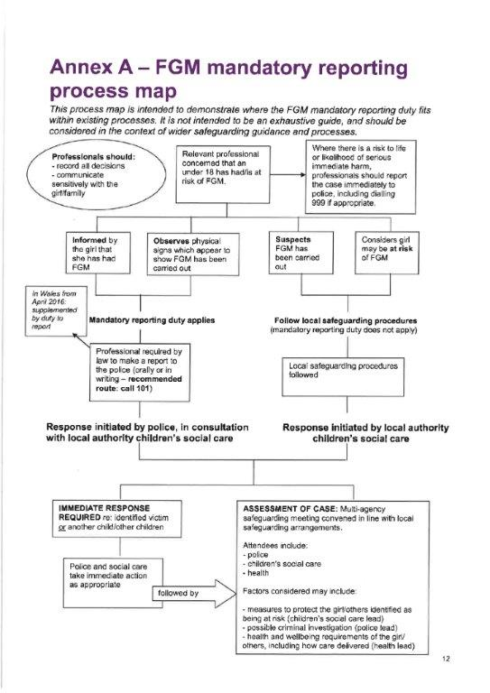

Slide 28
Failure to comply with the duty
Cases of failure to comply with the duty will be dealt with in accordance with the existing performance procedures in place for each profession. FGM is child abuse, and employers and the professional regulators are expected to pay due regard to the seriousness of breaches of the duty.

Slide 29
Health and social care professionals
For health and social care professionals, failure to comply with the duty may be considered through fitness to practise proceedings by the regulator with whom the professional is registered.
Regulators will use their frameworks to consider a professional’s ability currently to practise safely. This will therefore take all aspects of the circumstances of the case into consideration, including the safety of the individual child and her immediate needs. This may result in a wide variety of recommendations as to suitable action (e.g. re-training or supervision). Regulators may wish to issue guidance to their registrants as to how to act and when action may be taken

Slide 30
Teachers
For teachers, schools will need to consider any failure to comply with the duty in accordance with their staff disciplinary procedures. Where the school determines it is appropriate to dismiss the teacher as a result of the failure to comply, or the teacher would have been dismissed had they not resigned, the school must consider whether to refer the matter to the National College of Teaching and Leadership (NCTL) in England or the Education Workforce Council (EWC) in Wales, as regulators of the teaching profession.
For teachers in England, the NCTL will consider referrals to determine whether the facts presented in respect of the individual’s failure to comply with the duty are proven and whether they amount to unacceptable professional conduct or conduct likely to bring the profession into disrepute. If proven, the NCTL will consider whether it is appropriate to make a prohibition order which prevents the individual from carrying out teaching work in any school, children’s home, sixth form college, and relevant youth accommodation in England.
For teachers in Wales, in considering cases the EWC will look at the individual’s conduct and consider whether their failure to comply with the duty was so serious that it should affect their registration, which may include initiating fitness to practise proceedings.

Slide 31
Summary
The SCA 2015 amendments effects everyone individuals and organisations, as both have a duty towards an FGM victim.
The current impact is that parents can be guilty of a criminal offence if they fail to prevent a girl from being subjected to an FGM.
There is a mandatory duty on healthcare professionals, teachers and social workers in Wales to report FGM to the police, if they discover that that a girl is at risk or has undergone the procedure.
An FGM Protection Order can be obtained to prevent an FGM taking place or to protect a girl who has already been subjected to FGM.
Professionals should not fear appearing culturally insensitive or racist and must ask girls those direct questions is they have reason to suspect FGM or risk of FGM.

Slide 32
Useful Links
http://www.cps.gov.uk/legal/d_to_g/female_genital_mutilation/
https://www.gov.uk/government/uploads/system/uploads/attachment_data/file/469448/FGM-Mandatory-Reporting-procedural-info-FINAL.pdf

Slide 33
Contact Details
Anne-Marie Hutchinson
Dawson Cornwell Solicitors
15 Red Lion Square, London WC1R 4QT
Tel: 02072422556
Email: amh@dawsoncornwell.com
Website: www.dawsoncornwell.com
Twitter: @lawabduction

Slide 34
Thank you
ANY QUESTIONS?

